Slide 1

Sentence Classification
Devanshi Shah – 301175169
Shrikant Kale - 301150258
Jefil Tasna John Mohan - 301149710
Hitesh Dharmadhikari – 301150694

Slide 2
Description
A technology that can assist a user in quickly locating the information of interest is highly desired, as it may reduce the time required to locate relevant information.
Existing Projects and Research often skim through abstracts in order to quickly check whether the papers match. Also, this process is easier and more constrained when abstracts are structured, i.e., the text in an abstract is divided into semantic headings such as the objective, method, result, and conclusion.
However, a significant portion of abstracts or information is unstructured, which makes it more difficult to quickly access the information of interest. Therefore, classifying each sentence of an abstract into an appropriate heading can significantly reduce the time to locate the desired information
In this project, we describe an ANN architecture that combines the power of structured prediction with the efficiency of traditional ANN models for classifying individual words.
Our model reaches an optimal performance by leveraging a state-of-the-art model for generating text embeddings.

Slide 3
Scope of the problem
Existing sentence classification models based on Artificial Neural Networks (ANNs) frequently classify sentences separately without taking into account the context in which they appear.
However, it has been demonstrated that jointly classifying subsequent sentences, such as utilizing conditional random fields, considerably benefits conventional sentence classification algorithms.
In order to convert unstructured data to a structure formative, we propose a solution which is a sequential sentence classification task, in order to distinguish it from general text classification or sentence classification that does not have any context. Our project is based on ANNs for the sequential sentence classification task.
Our model makes use of both token and character embeddings for classifying sentences and has a sequence optimization layer that is learned jointly with other components of the model.

Slide 4

The Dataset
We are evaluating our model on the sentence classification task using the PubMed 200k medical abstract datasets
Each sentence of the abstract is annotated with one label
we are splitting the sentence into major 5 labels: objectives, background, methods, results, and conclusions.
The dataset consists of 200k out of which we are considering 20k values.
The dataset has three major files: test.txt, train.txt, and dev.txt.

Slide 5
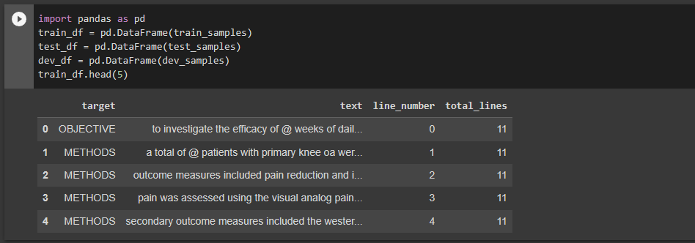
Preprocessing
Converting dictionaries for train, test, and dev to the data frame
Extracting text into lists, applying One Hot encoder and Label encoder

Slide 6
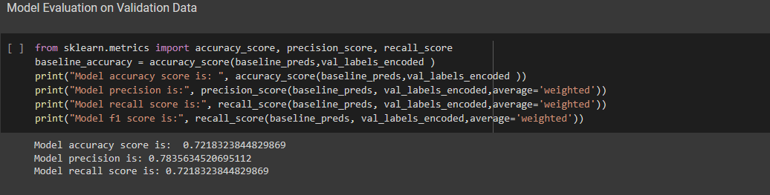
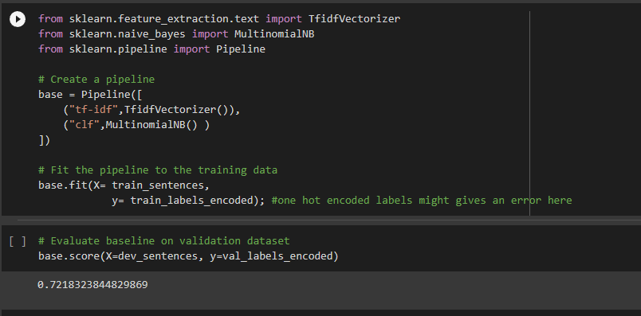
Baseline model
We first developed a baseline model to evaluate the performance and to compare it against all future models
It is a multinomial Naive base model
Model accuracy score is: 0.7218323844829869
Model precision is: 0.7835634520695112
Model recall score is: 0.7218323844829869
Model f1 score is: 0.7447397336209445

Slide 7
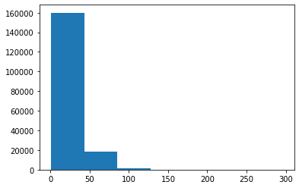
Data Preparation for Deep Sequence Models
Checking the average length of each sentence
Evaluating the length of 95% of sentences. This will be used as the max length for sentences when training the model as we want all sentences to be of the same length.
The length of sentences will be 55. We will truncate sentences with lengths greater than 55 and pad sentences with 0 that are less than 55.
Implementing Text Vectorizer and Text Embedding needed to learn the relationship between tokens in our data

Slide 8
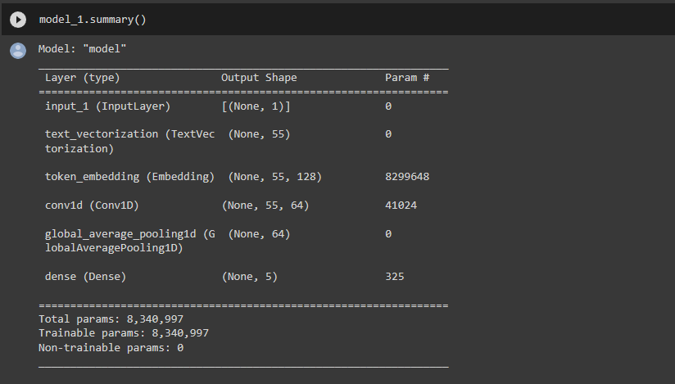
Supervised
Supervised Learning Model : Conv1D with token embeddings
Model accuracy score is: 0.7848206010856613
Model precision is: 0.7908618079141329
Model recall score is: 0.7848206010856613

Slide 9
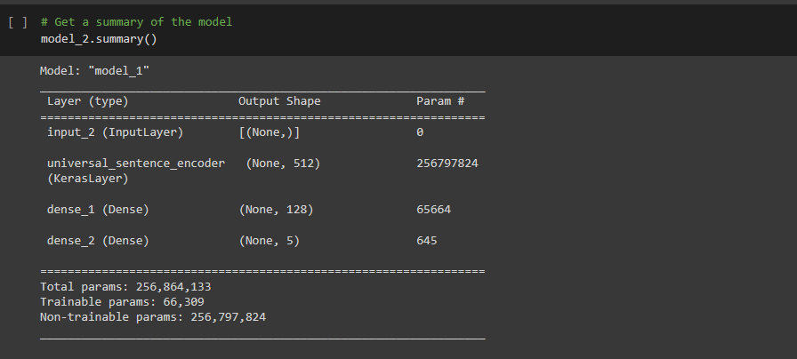
unsupervised
Unsupervised Learning Model: Feature extraction with pre-trained token embedding
The tensor flow hub Universal sentence encoder is used.
Model accuracy score is: 0.7143850125777836
Model precision is: 0.7249763106810531
Model recall score is: 0.7143850125777836

Slide 10
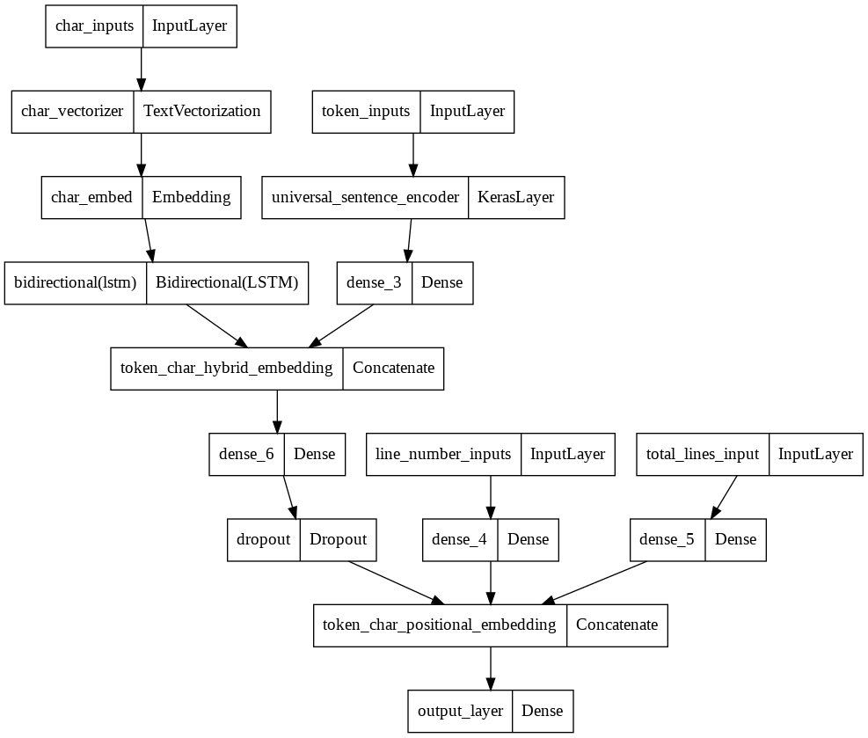
State of the art
State of the art Model – which is a Pretrained Model incorporates Char Embedding and Positional embedding
Model accuracy score is: 0.8309281080365418
Model precision is: 0.8336692432740671
Model recall score is: 0.8309281080365418

Slide 11
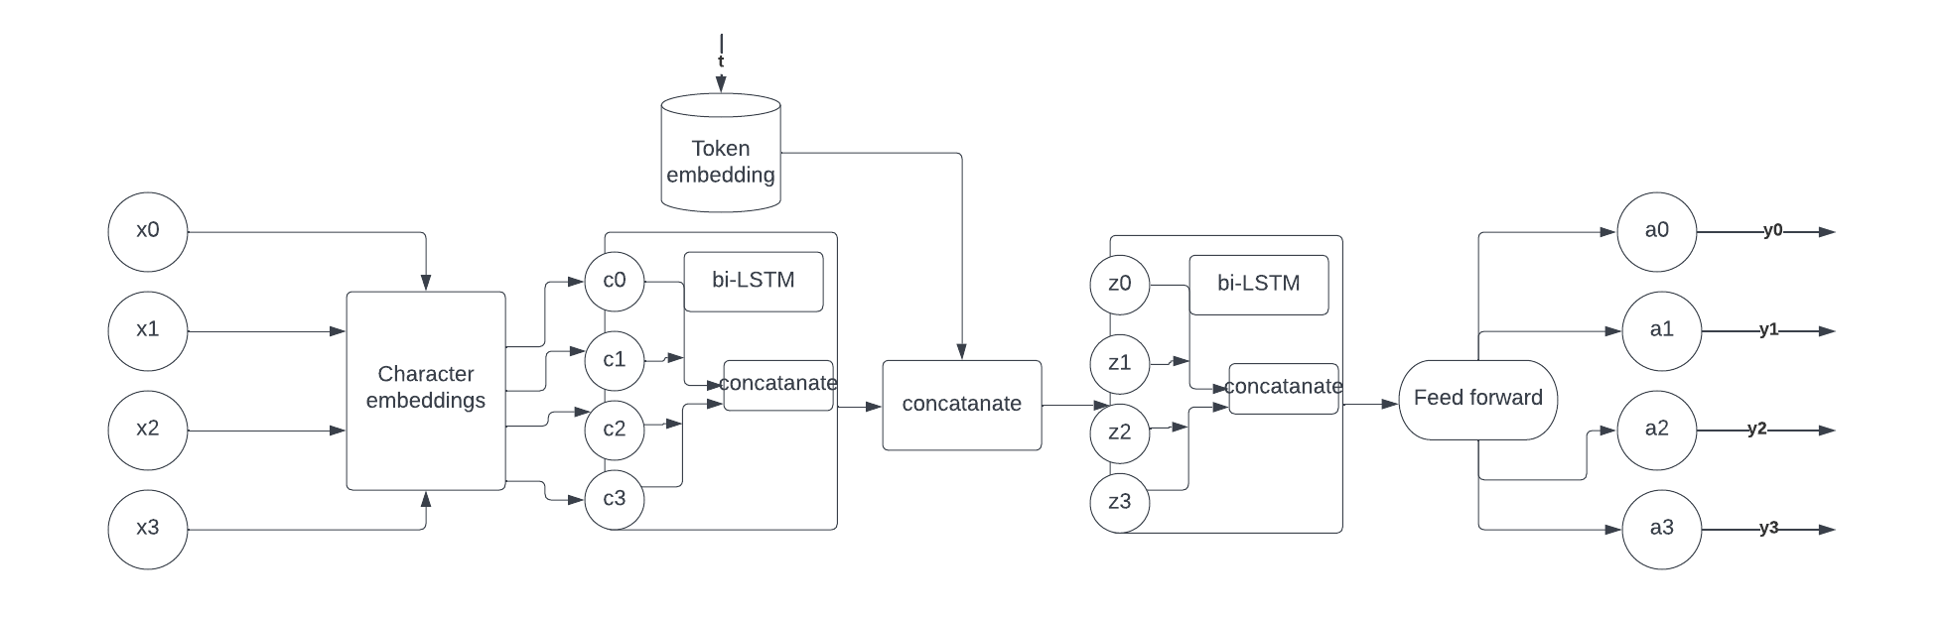
STRUCTURE OF Sentence classification

Slide 12
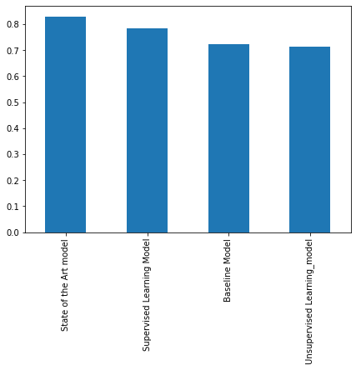
Result
We can observe that the State-of-the-art model is giving us the best results
Metrics | Baseline model | Model1 | Model2 | Model3
Precision | 0.78 | 0.79 | 0.73 | 0.83
Recall | 0.72 | 0.78 | 0.71 | 0.83
F1-score | 0.74 | 0.79 | 0.72 | 0.83
Accuracy | 0.72 | 0.78 | 0.72 | 0.83

Slide 13
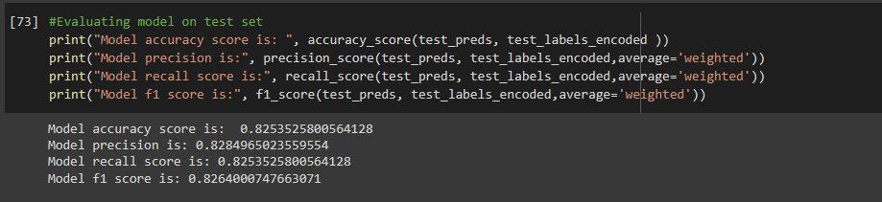
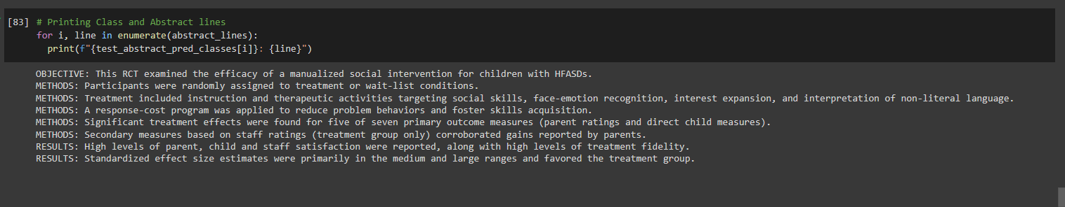
Model Evaluation and prediction
OBJECTIVE: This RCT examined the efficacy of a manualized social intervention for children with HFASDs.
METHODS: Participants were randomly assigned to treatment or wait-list conditions.
METHODS: Treatment included instruction and therapeutic activities targeting social skills, face-emotion recognition, interest expansion, and interpretation of non-literal language.
METHODS: A response-cost program was applied to reduce problem behaviors and foster skills acquisition. METHODS: Significant treatment effects were found for five of seven primary outcome measures (parent ratings and direct child measures).
METHODS: Secondary measures based on staff ratings (treatment group only) corroborated gains reported by parents.
RESULTS: High levels of parent, child and staff satisfaction were reported, along with high levels of treatment fidelity. RESULTS: Standardized effect size estimates were primarily in the medium and large ranges and favored the treatment group.

Slide 14
Code Demo

Slide 15
challenges
Preprocessing and visualizing the text to line numbers in the dataset was difficult
It was challenging to select and combine model for getting better results
Preparing text for model evaluation was a complex procedure.

Slide 16
Thank you

